Slide 1
Securing Personal Data Through Blockchain
By
Aneesh Adithya SR 1RVU23CSE054
Sohan Gowda LC 1RVU23CSE460
Nabila 1RVU23CSE294

Slide 2
What is Blockchain?
Blockchain is a secure and transparent digital ledger technology that records transactions in a decentralized network.

Slide 3
Features
Security: Protects data from being tampered with.
Transparency: Everyone can see the transactions.
Decentralization: No single point of control.
Immutability: Once recorded, data cannot be changed.

Slide 4
Why Blockchain?
Enhanced Security: Provides strong protection against data tampering.
Transparency & Trust: Everyone sees the same verified data.
Efficiency & Speed: Streamlines transactions without middlemen.
Cost Reduction: Cuts costs by removing intermediaries and reducing errors.

Slide 5
Advantages
Decentralization: No central authority controls the data.
Immutability: Data, once recorded, cannot be altered.
Data Integrity: Ensures accuracy and consistency of information.
Smart Contracts: Automates agreements with self-executing contracts.

Slide 6
Our Dataset-Student Scores
Student Information: First name, last name, email, gender.
Academic Details: Scores in various subjects and total score.
Activities & Aspirations: Absence days, extracurricular activities, career goals

Slide 7
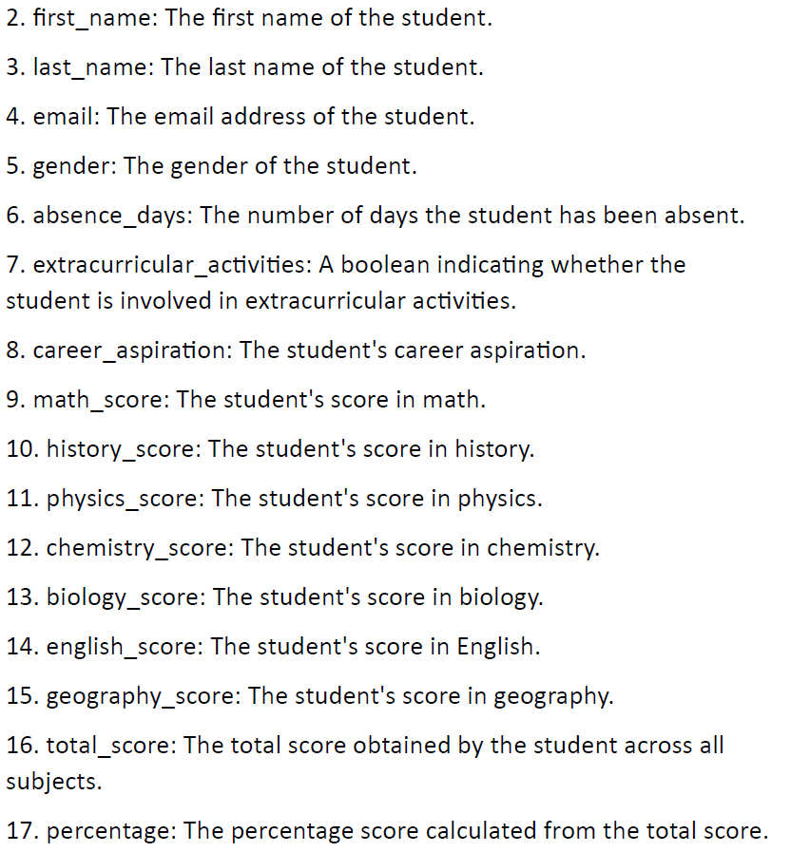

Slide 8
Disadvantages
High Energy Consumption: Requires significant computational power.
Scalability Issues: Limited transaction processing speed.
Regulatory Uncertainty: Evolving legal frameworks.
Complexity: Technical expertise required for implementation.

Slide 9
Implementation of data using Solidity and Metamask
Solidity is a smart contract programming language for the Ethereum blockchain. It enables the creation of secure, self-executing agreements that are tamper-proof. This language is essential for building decentralized applications (dApps) and managing complex transactions, providing transparency and reducing the need for intermediaries.
MetaMask is a browser extension that serves as a digital wallet and gateway to the Ethereum blockchain. It allows users to securely manage their digital assets, sign transactions, and interact with decentralized applications (dApps) directly from their browser, facilitating easy and secure access to the blockchain ecosystem.

Slide 10
Working of the Solidity Code with Metamask Extension
Demonstration

Slide 11
Conclusion
Blockchain technology offers enhanced security, transparency, and efficiency by decentralizing data management and ensuring immutability. While it has challenges like high energy consumption and scalability issues, its benefits, including smart contracts and cost reduction, make it a promising solution for secure and efficient transactions across various sectors.

